Slide 1

DIVINE GRACE COLLEGE OF ARTS, SCIENCE AND TECHNOLOGY
(DGCAST) — GAROUA | GEOGRAPHY DEPARTMENT
UPPER SIXTH ARTS — PRACTICAL GEOGRAPHY — MAP ANALYSIS 3
Relief on Maps
Mr KAMDEM EMMANUEL
Geography Teacher — PLEG
Academic Year 2026 / 2027
Notes:
Good morning, class. Today we study Map Analysis 3: Relief on Maps.

Slide 2
GEOGRAPHY — UPPER SIXTH ARTS
CLASS INFO
Class, Chapter & Duration
Class | Upper Sixth Arts
Chapter | Module 8: Understanding and carrying out statistical techniques, topographic map analysis, fieldwork and project based learning
Duration | 2 periods (2 × 50 minutes)
2026 / 2027
DGCAST GAROUA — GEOGRAPHY DEPARTMENT
Mr KAMDEM E. | 2

Slide 3
GEOGRAPHY — UPPER SIXTH ARTS
IDENTIFICATION
Lesson Identification
Topic | Topographic Map Analysis
Sub-topic | Geomorphological Analysis
Lesson | Map Analysis 3: Relief on Maps
Notions / Concepts | Relief, landform, spur, valley, escarpment, plateau, cross-section, relief region, floodplain, meander, cliff, spit.
Syllabus focus | Contour patterns and landforms; relief regions (sketch, description, explanation); fluvial features and drainage; coastal landforms.
Competence | Learners are able to identify landforms, draw cross-sections and describe relief regions from a map.
2026 / 2027
DGCAST GAROUA — GEOGRAPHY DEPARTMENT
Mr KAMDEM E. | 3

Slide 4
GEOGRAPHY — UPPER SIXTH ARTS
OBJECTIVES
Learning Objectives
By the end of the lesson, the learner should be able to:
Identify landforms from contour patterns.
Draw a cross-section and a relief sketch map.
Identify fluvial and coastal landforms on maps.
2026 / 2027
DGCAST GAROUA — GEOGRAPHY DEPARTMENT
Mr KAMDEM E. | 4

Slide 5
GEOGRAPHY — UPPER SIXTH ARTS
RECALL
Recall
Contours show height.
Close contours show steep slopes.
2026 / 2027
DGCAST GAROUA — GEOGRAPHY DEPARTMENT
Mr KAMDEM E. | 5

Slide 6
GEOGRAPHY — UPPER SIXTH ARTS
REAL-LIFE SITUATION
Real-Life Situation
In the GCE exam, students are asked to draw a sketch map of the relief regions of a map extract, draw a cross-section from X to Y and identify landforms along the river and the coast.
2026 / 2027
DGCAST GAROUA — GEOGRAPHY DEPARTMENT
Mr KAMDEM E. | 6
Notes:
Read the situation slowly, twice.

Slide 7
GEOGRAPHY — UPPER SIXTH ARTS
REAL-LIFE SITUATION
Situation — Question 1
What is the problem in the situation?
2026 / 2027
DGCAST GAROUA — GEOGRAPHY DEPARTMENT
Mr KAMDEM E. | 7

Slide 8
GEOGRAPHY — UPPER SIXTH ARTS
REAL-LIFE SITUATION
Answer
Students must analyse relief on a map.
2026 / 2027
DGCAST GAROUA — GEOGRAPHY DEPARTMENT
Mr KAMDEM E. | 8

Slide 9
GEOGRAPHY — UPPER SIXTH ARTS
REAL-LIFE SITUATION
Situation — Question 2
What shows landforms on a map?
2026 / 2027
DGCAST GAROUA — GEOGRAPHY DEPARTMENT
Mr KAMDEM E. | 9

Slide 10
GEOGRAPHY — UPPER SIXTH ARTS
REAL-LIFE SITUATION
Answer
Contour patterns.
2026 / 2027
DGCAST GAROUA — GEOGRAPHY DEPARTMENT
Mr KAMDEM E. | 10

Slide 11
GEOGRAPHY — UPPER SIXTH ARTS
REAL-LIFE SITUATION
Situation — Question 3
What drawing shows the shape of land along a line?
2026 / 2027
DGCAST GAROUA — GEOGRAPHY DEPARTMENT
Mr KAMDEM E. | 11

Slide 12
GEOGRAPHY — UPPER SIXTH ARTS
REAL-LIFE SITUATION
Possible Answer
A cross-section.
2026 / 2027
DGCAST GAROUA — GEOGRAPHY DEPARTMENT
Mr KAMDEM E. | 12

Slide 13
GEOGRAPHY — UPPER SIXTH ARTS
JUSTIFICATION
Justification of the Lesson
This lesson helps us to describe and explain relief from map evidence.
2026 / 2027
DGCAST GAROUA — GEOGRAPHY DEPARTMENT
Mr KAMDEM E. | 13

Slide 14
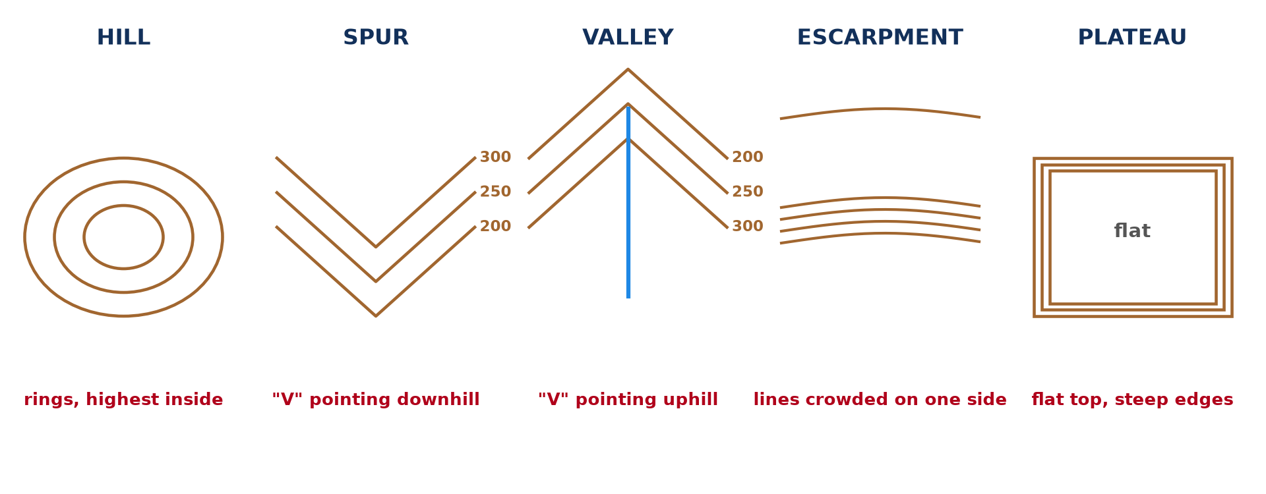
GEOGRAPHY — UPPER SIXTH ARTS
I. CONTOUR PATTERNS
Activity 1
Landforms from contours.
2026 / 2027
DGCAST GAROUA — GEOGRAPHY DEPARTMENT
Mr KAMDEM E. | 14
Notes:
Without the projector: draw both.

Slide 15
GEOGRAPHY — UPPER SIXTH ARTS
I. CONTOUR PATTERNS
Activity 1: Question
How can you tell a spur from a valley?
2026 / 2027
DGCAST GAROUA — GEOGRAPHY DEPARTMENT
Mr KAMDEM E. | 15

Slide 16
GEOGRAPHY — UPPER SIXTH ARTS
I. CONTOUR PATTERNS
Answer
A spur's contours point downhill; a valley's point uphill and often contain a river.
2026 / 2027
DGCAST GAROUA — GEOGRAPHY DEPARTMENT
Mr KAMDEM E. | 16

Slide 17

GEOGRAPHY — UPPER SIXTH ARTS
II. RELIEF REGIONS
Activity 2
A relief extract (invented).
2026 / 2027
DGCAST GAROUA — GEOGRAPHY DEPARTMENT
Mr KAMDEM E. | 17
Notes:
Without the projector: sketch the regions.

Slide 18
GEOGRAPHY — UPPER SIXTH ARTS
II. RELIEF REGIONS
Activity 2: Question
Name the relief regions on the extract.
2026 / 2027
DGCAST GAROUA — GEOGRAPHY DEPARTMENT
Mr KAMDEM E. | 18

Slide 19
GEOGRAPHY — UPPER SIXTH ARTS
II. RELIEF REGIONS
Answer
A highland in the north-west, a river valley, a lowland plain and an isolated hill in the south-east.
2026 / 2027
DGCAST GAROUA — GEOGRAPHY DEPARTMENT
Mr KAMDEM E. | 19

Slide 20
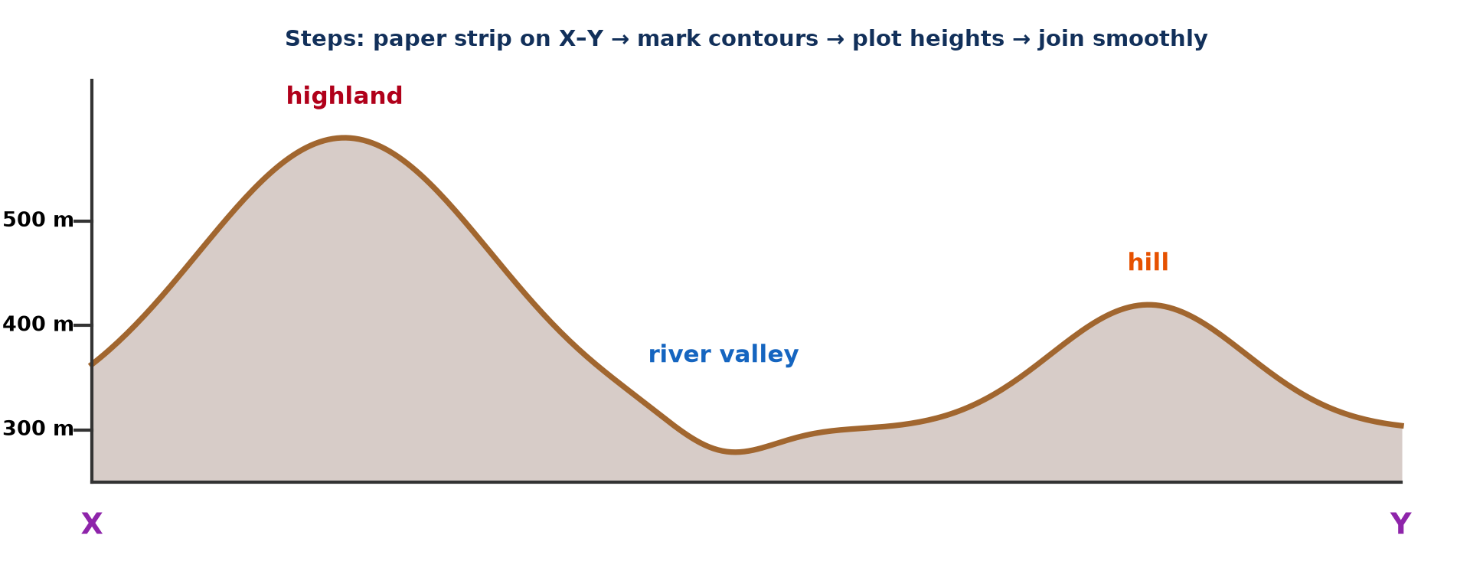
GEOGRAPHY — UPPER SIXTH ARTS
II. CROSS-SECTION
Activity 3
Cross-section X–Y.
2026 / 2027
DGCAST GAROUA — GEOGRAPHY DEPARTMENT
Mr KAMDEM E. | 20
Notes:
Without the projector: draw a section.

Slide 21
GEOGRAPHY — UPPER SIXTH ARTS
II. CROSS-SECTION
Activity 3: Question
Give the steps to draw a cross-section.
2026 / 2027
DGCAST GAROUA — GEOGRAPHY DEPARTMENT
Mr KAMDEM E. | 21

Slide 22
GEOGRAPHY — UPPER SIXTH ARTS
II. CROSS-SECTION
Answer
Place a paper strip on X–Y, mark contours, plot heights on a graph and join them smoothly.
2026 / 2027
DGCAST GAROUA — GEOGRAPHY DEPARTMENT
Mr KAMDEM E. | 22

Slide 23
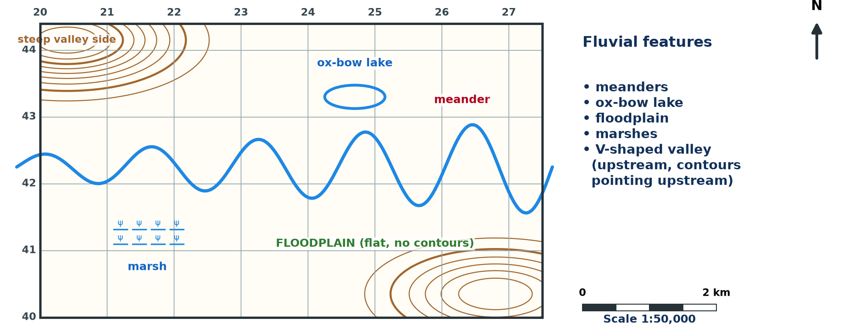
GEOGRAPHY — UPPER SIXTH ARTS
III. FLUVIAL FEATURES
Activity 4
River features (invented).
2026 / 2027
DGCAST GAROUA — GEOGRAPHY DEPARTMENT
Mr KAMDEM E. | 23
Notes:
Without the projector: identify features.

Slide 24
GEOGRAPHY — UPPER SIXTH ARTS
III. FLUVIAL FEATURES
Activity 4: Question
Name three fluvial features shown.
2026 / 2027
DGCAST GAROUA — GEOGRAPHY DEPARTMENT
Mr KAMDEM E. | 24

Slide 25
GEOGRAPHY — UPPER SIXTH ARTS
III. FLUVIAL FEATURES
Answer
Meanders, an ox-bow lake and a floodplain with marshes.
2026 / 2027
DGCAST GAROUA — GEOGRAPHY DEPARTMENT
Mr KAMDEM E. | 25

Slide 26
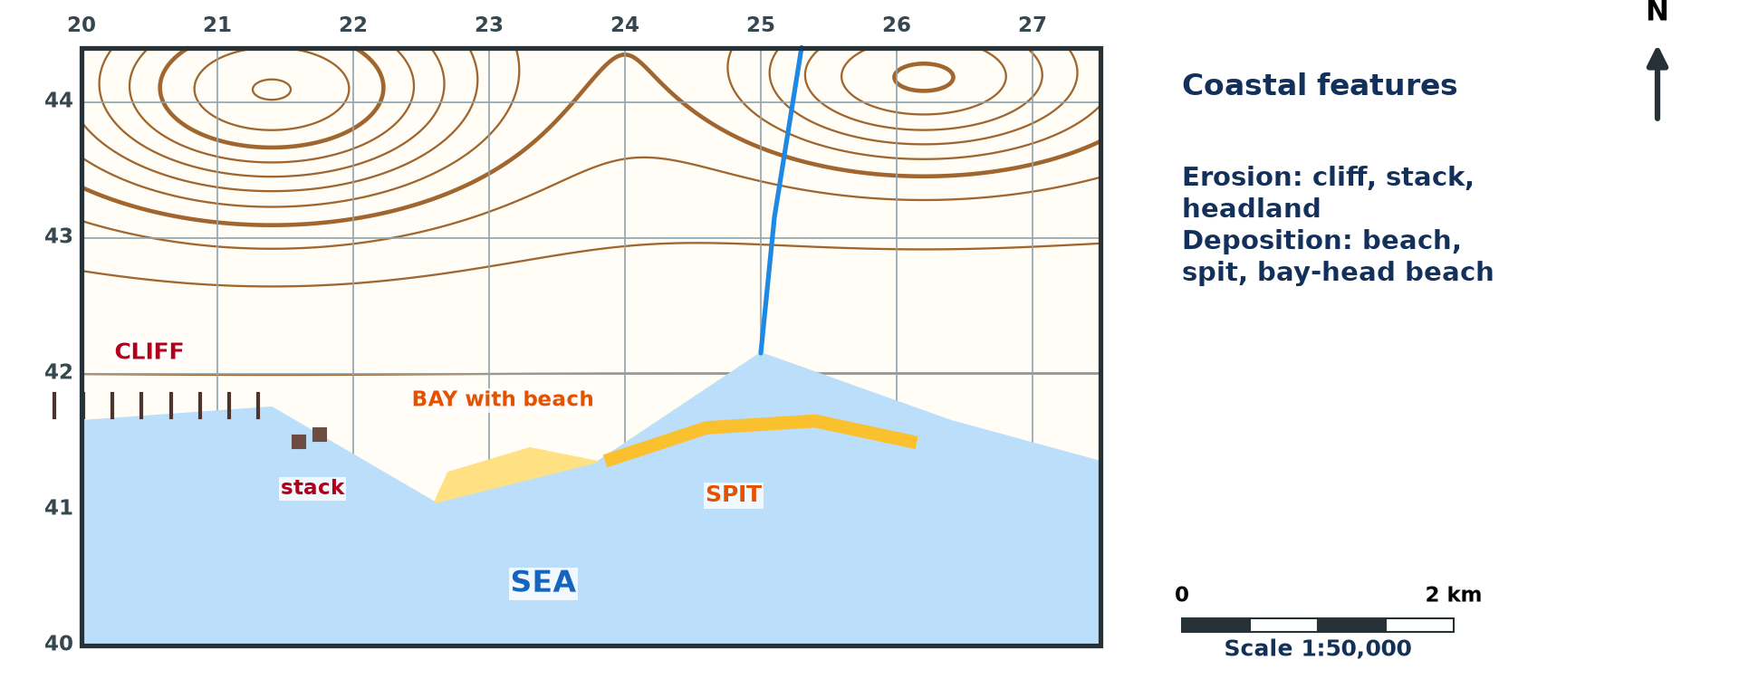
GEOGRAPHY — UPPER SIXTH ARTS
IV. COASTAL LANDFORMS
Activity 5
Coastal features (invented).
2026 / 2027
DGCAST GAROUA — GEOGRAPHY DEPARTMENT
Mr KAMDEM E. | 26
Notes:
Without the projector: identify features.

Slide 27
GEOGRAPHY — UPPER SIXTH ARTS
IV. COASTAL LANDFORMS
Activity 5: Question
Name one erosional and one depositional coastal landform.
2026 / 2027
DGCAST GAROUA — GEOGRAPHY DEPARTMENT
Mr KAMDEM E. | 27

Slide 28
GEOGRAPHY — UPPER SIXTH ARTS
IV. COASTAL LANDFORMS
Answer
Erosional: cliff (or stack). Depositional: spit (or beach).
2026 / 2027
DGCAST GAROUA — GEOGRAPHY DEPARTMENT
Mr KAMDEM E. | 28

Slide 29
GEOGRAPHY — UPPER SIXTH ARTS
BOARD SUMMARY
Relief on Maps
Topic: Topographic Map Analysis
Sub-topic: Geomorphological Analysis
Map Analysis 3: Relief on Maps
2026 / 2027
DGCAST GAROUA — GEOGRAPHY DEPARTMENT
Mr KAMDEM E. | 29
Notes:
Learners copy the board summary now. Give them enough time for each slide.

Slide 30
GEOGRAPHY — UPPER SIXTH ARTS
BOARD SUMMARY
I. Definitions
Relief: It is the shape and height of the land surface.
Cross-section: It is a side view of the land along a line on the map.
Relief region: It is an area with similar height and slopes.
2026 / 2027
DGCAST GAROUA — GEOGRAPHY DEPARTMENT
Mr KAMDEM E. | 30

Slide 31
GEOGRAPHY — UPPER SIXTH ARTS
BOARD SUMMARY
II. Landforms and Regions (1/3)
A. Contour patterns: Rings show hills, V-shapes show spurs and valleys, and crowded lines show escarpments. Flat tops with steep edges show plateaus.
B. Relief regions: Draw a sketch map of highlands, lowlands and valleys. Describe their height and slopes and explain them.
2026 / 2027
DGCAST GAROUA — GEOGRAPHY DEPARTMENT
Mr KAMDEM E. | 31

Slide 32
GEOGRAPHY — UPPER SIXTH ARTS
BOARD SUMMARY
II. Landforms and Regions (2/3)
C. Cross-sections: Mark contours on a strip and plot them to scale. Label landforms and state the vertical exaggeration.
2026 / 2027
DGCAST GAROUA — GEOGRAPHY DEPARTMENT
Mr KAMDEM E. | 32

Slide 33
GEOGRAPHY — UPPER SIXTH ARTS
BOARD SUMMARY
II. Landforms and Regions (3/3)
Copy the section.
2026 / 2027
DGCAST GAROUA — GEOGRAPHY DEPARTMENT
Mr KAMDEM E. | 33

Slide 34
GEOGRAPHY — UPPER SIXTH ARTS
BOARD SUMMARY
III. Fluvial and Coastal Landforms
A. Fluvial: Upstream valleys are V-shaped; downstream there are meanders, ox-bow lakes and floodplains. Rivers flow from high to low ground.
B. Coastal: Cliffs and stacks are erosional features. Beaches and spits are depositional features.
2026 / 2027
DGCAST GAROUA — GEOGRAPHY DEPARTMENT
Mr KAMDEM E. | 34

Slide 35
GEOGRAPHY — UPPER SIXTH ARTS
FORMATIVE EVALUATION
Formative Evaluation 1
Describe the contour pattern of a plateau.
2026 / 2027
DGCAST GAROUA — GEOGRAPHY DEPARTMENT
Mr KAMDEM E. | 35

Slide 36
GEOGRAPHY — UPPER SIXTH ARTS
FORMATIVE EVALUATION
Expected Answer
Flat top with widely spaced contours and crowded contours at the edges.
2026 / 2027
DGCAST GAROUA — GEOGRAPHY DEPARTMENT
Mr KAMDEM E. | 36

Slide 37
GEOGRAPHY — UPPER SIXTH ARTS
FORMATIVE EVALUATION
Formative Evaluation 2
Name two fluvial features of the lower course.
2026 / 2027
DGCAST GAROUA — GEOGRAPHY DEPARTMENT
Mr KAMDEM E. | 37

Slide 38
GEOGRAPHY — UPPER SIXTH ARTS
FORMATIVE EVALUATION
Expected Answer
Meanders and ox-bow lakes.
2026 / 2027
DGCAST GAROUA — GEOGRAPHY DEPARTMENT
Mr KAMDEM E. | 38

Slide 39
GEOGRAPHY — UPPER SIXTH ARTS
REMEDIATION
Remediation
Fill in the blanks:
Contours pointing downhill show a ______.
A side view of land is a cross-______.
A curved ridge of sand into the sea is a ______.
2026 / 2027
DGCAST GAROUA — GEOGRAPHY DEPARTMENT
Mr KAMDEM E. | 39
Notes:
Answers: 1. spur 2. section 3. spit

Slide 40
GEOGRAPHY — UPPER SIXTH ARTS
HOMEWORK
Homework
Draw the cross-section X–Y from the extract and label the landforms.
This prepares Map Analysis 4: Drainage on Maps.
2026 / 2027
DGCAST GAROUA — GEOGRAPHY DEPARTMENT
Mr KAMDEM E. | 40
Notes:
This homework prepares the next lesson.

Slide 41
GEOGRAPHY — UPPER SIXTH ARTS
BILINGUAL GAME
Bilingual Game (Jeu Bilingue)
English | Français
Relief | Le relief
Cross-section | La coupe topographique
Spur | L'éperon
Valley | La vallée
Cliff | La falaise
Plateau | Le plateau
2026 / 2027
DGCAST GAROUA — GEOGRAPHY DEPARTMENT
Mr KAMDEM E. | 41
Notes:
Say the English word; learners give the French word, then the reverse.

Slide 42
GEOGRAPHY — UPPER SIXTH ARTS
LOGBOOK
Official Logbook (1/2)
Module / Topic | Topographic Map Analysis
Lesson Title | Map Analysis 3: Relief on Maps
Expected Learning Outcomes | Identify landforms from contour patterns. Draw a cross-section and a relief sketch map. Identify fluvial and coastal landforms on maps.
Competence | Learners are able to identify landforms, draw cross-sections and describe relief regions from a map.
2026 / 2027
DGCAST GAROUA — GEOGRAPHY DEPARTMENT
Mr KAMDEM E. | 42

Slide 43
GEOGRAPHY — UPPER SIXTH ARTS
LOGBOOK
Official Logbook (2/2)
Matter Taught | I. Definitions: Relief, Cross-section, Relief region; II. Landforms and Regions: Contour patterns, Relief regions, Cross-sections; III. Fluvial and Coastal Landforms: Fluvial, Coastal.
Evaluation | Formative evaluation (3 questions) and remediation exercise.
Homework | Draw the cross-section X–Y from the extract and label the landforms.
Enrolment / Present / Absent | ____ / ____ / ____
Achievement | To be completed by the teacher after the lesson.
2026 / 2027
DGCAST GAROUA — GEOGRAPHY DEPARTMENT
Mr KAMDEM E. | 43

Slide 44
GEOGRAPHY — UPPER SIXTH ARTS
TEACHER'S NOTE
Teacher's Note
Timing: Set-up, recall 8 min | Situation 8 min | 5 activities 30 min | Board summary (copying) 30 min | Evaluation, remediation 10 min | Homework, logbook 9 min | Spare 5 min
2026 / 2027
DGCAST GAROUA — GEOGRAPHY DEPARTMENT
Mr KAMDEM E. | 44

Slide 45
GEOGRAPHY — UPPER SIXTH ARTS
REFERENCES
References
National Geography Syllabus, Sixth Forms (Lower & Upper Sixth), MINESEC/IGE/IP-SS, August 2019 — Module 8 (Practical Geography).
Diagrams and animations: drawn for this lesson (DGCAST Geography Department).
2026 / 2027
DGCAST GAROUA — GEOGRAPHY DEPARTMENT
Mr KAMDEM E. | 45

